Slide 1
DATA SCIENCE FOR ECONOMISTS
ECON 220 LAB
Jafet Baca-Obando
Week 10, Central Limit Theorem – 10/31/2025

Slide 2
Outline
01 | Distribution of a sample mean
02 | Central limit theorem
03 | Distribution of a sample proportion

Slide 3
Announcement
Extra credit earned in the Lab can only be applied to the Lab portion of your grade, which is worth 25% of your overall grade in ECON 220.
The maximum score for the entire Lab component is capped at 25% of your final grade, even if extra credit would otherwise raise it higher.
In short: Lab extra credit can help you get up to the full 25% for the lab, but it cannot raise your score in the theory component.

Slide 4
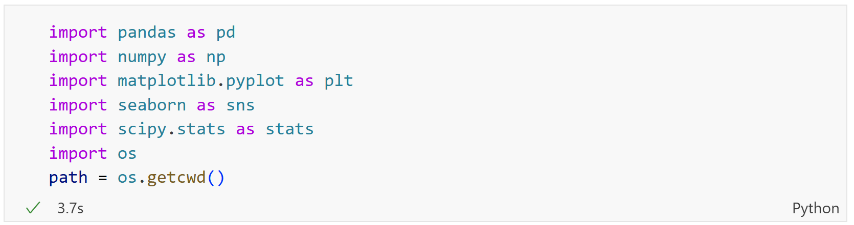
Importing required libraries

Slide 5
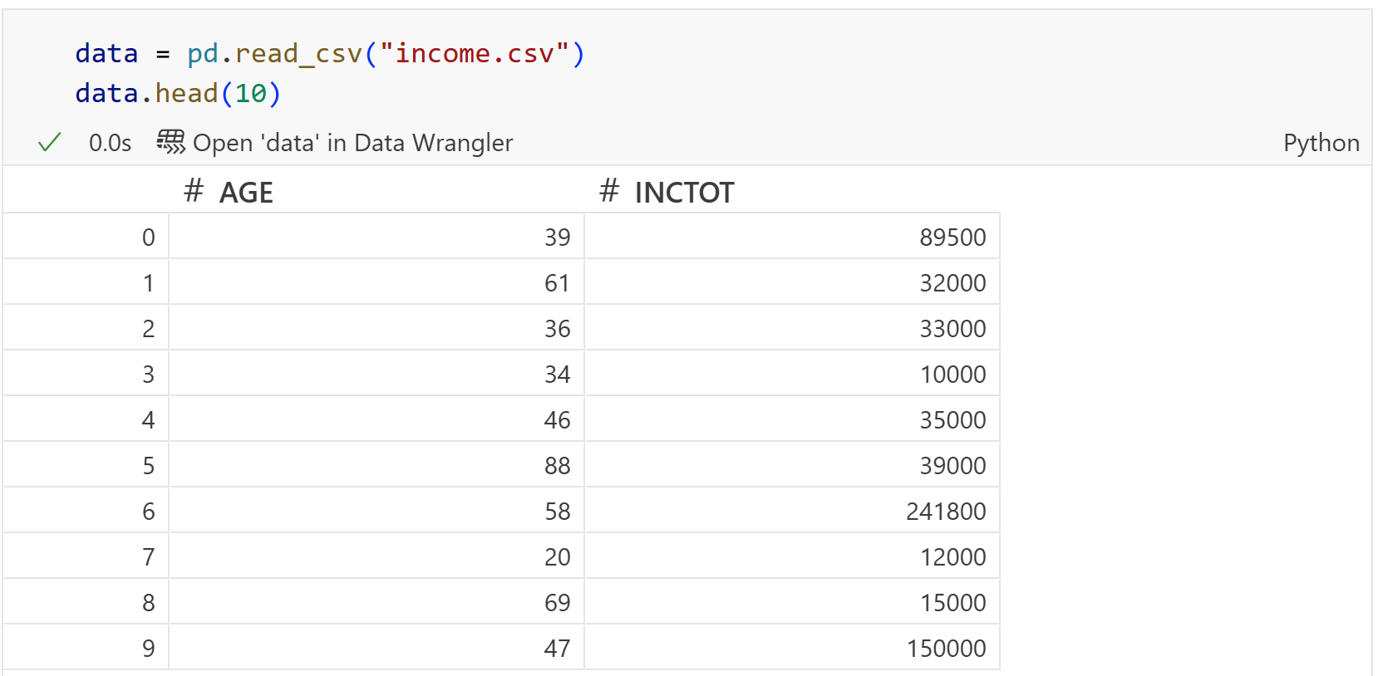
Load the dataset
Our dataset: a sample of 10,000 individuals from 2023 IPUMS data.

Slide 6
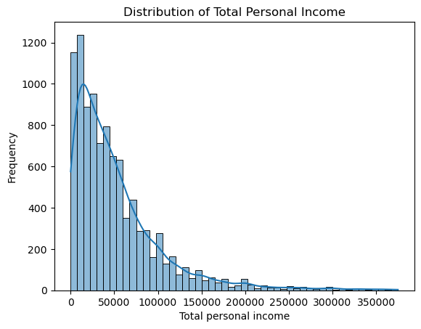
Sampling distribution of the sample mean
Distribution of personal income: right skewed, non-normal

Slide 7
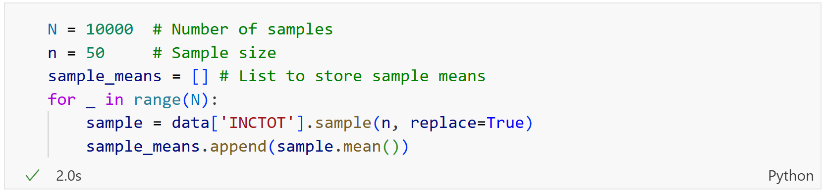
Sampling distribution of the sample mean
Let's run a simulation. Instead of looking at the whole population, let's look at sample means.
  Take a random sample of n = 50 people from the income data.
  Calculate the mean income of that sample.
  Repeat this process 10,000 times.
This gives us a new dataset: a list of 10,000 sample means.

Slide 8
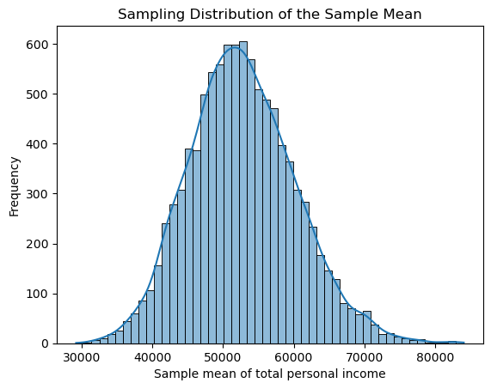
The result: a normal distribution
This is what we call the Central Limit Theorem.
Mean of this sample: 52758.6. Population mean: 52635.0046

Slide 9
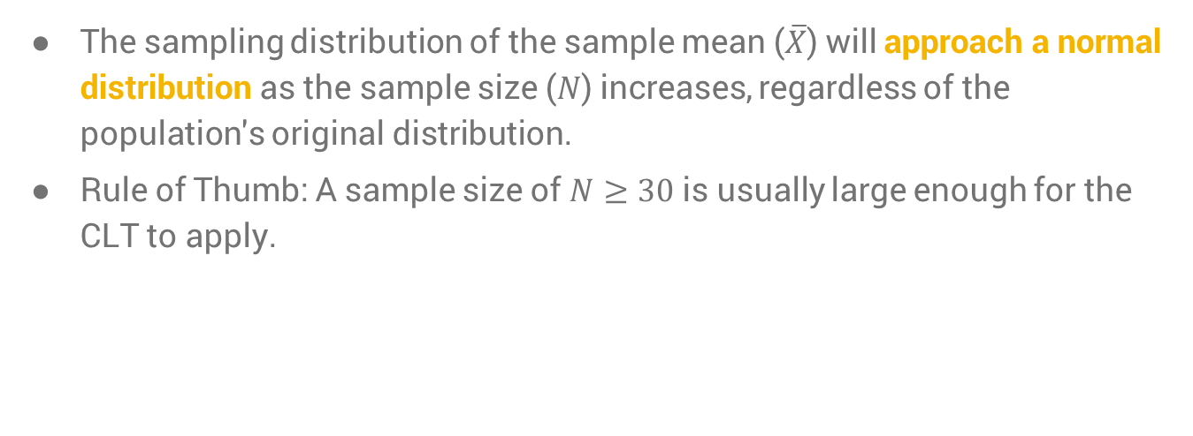
Central Limit Theorem
The sampling distribution of the sample mean ($\overline{X}$) will approach a normal distribution as the sample size ($N$) increases, regardless of the population's original distribution.
Rule of Thumb: A sample size of $N≥30$ is usually large enough for the CLT to apply.

Slide 10
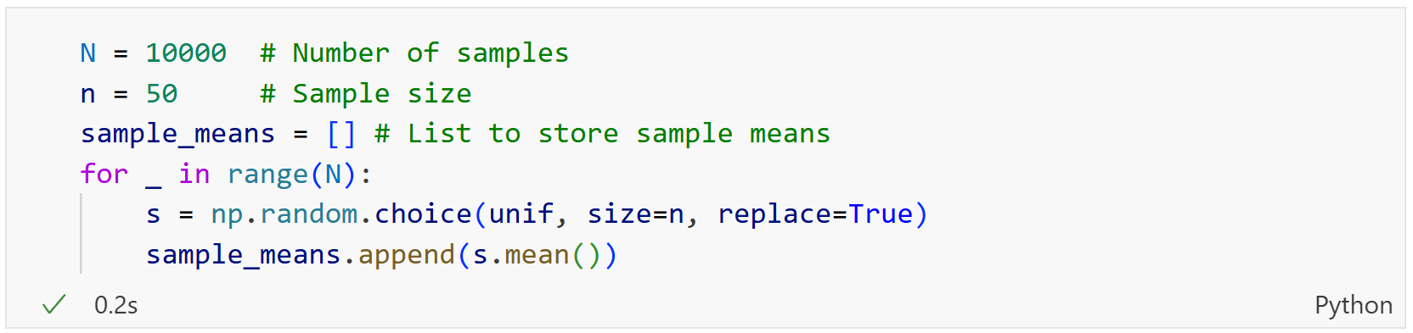
Testing the CLT with the uniform distribution

Slide 11
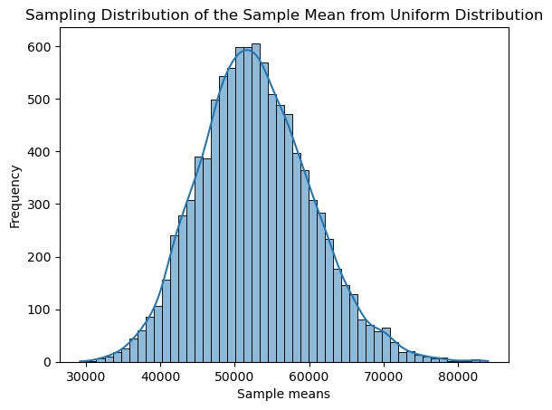
Testing the CLT with the uniform distribution

Slide 12
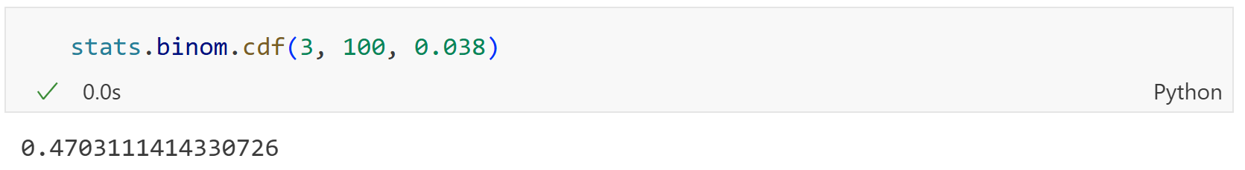

Sampling distribution for a sample proportion
The CLT doesn't just apply to means—it also applies to proportions.
Example: The unemployment rate in a population is 3.8% ($p = 0.038$). The exact probability of finding 3 or fewer unemployed people in a sample of 100 is given by the Binomial distribution.

Slide 13
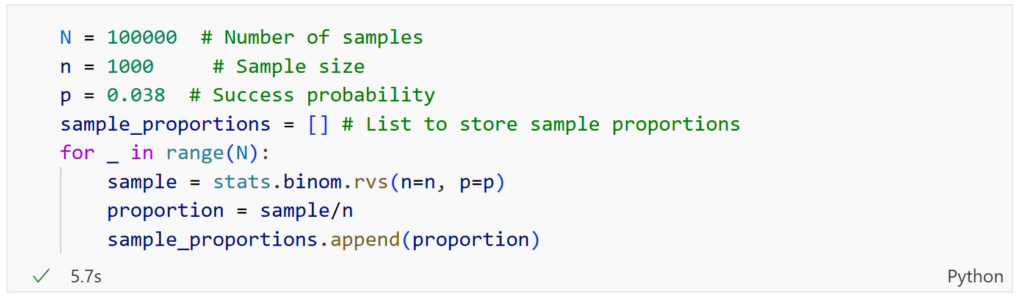

The CLT for proportions
Instead of the Binomial, the CLT tells us we can approximate the sampling distribution of a proportion with a normal distribution with mean $p$ and variance $\frac{p(1−p)}{n}$.

Slide 14
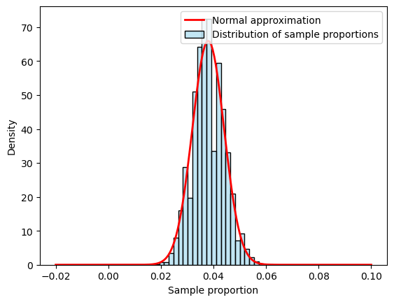
The CLT for proportions

Slide 15
Recap
The CLT is a fundamental theorem that allows us to make inferences about a population from a sample.
Even if a population is not normal, the distribution of its sample means will be approximately normal.
This principle holds true for both sample means and sample proportions.
A sample size of at least 30 is the general rule of thumb for the CLT to apply.
Key to conducting hypothesis testing and building confidence intervals.

Slide 16
To-do list
Complete Data Exercise 6
  Upload Jupyter notebook (.ipynb file) and HTML file on November 2
Complete Data Exercise 8
  Upload Jupyter notebook (.ipynb file) and HTML file on November 9

